Slide 1
Chapter 2: Elementary Programming

Slide 2
Sample java calculation program
public class ComputeArea {
/** Main method */
public static void main(String[] args) {
double radius;
double area;
// Assign a radius
radius = 20;
// Compute area
area = radius * radius * 3.14159;
// Display results
System.out.println("The area for the circle of radius " +
radius + " is " + area);
}
}
memory
radius
no value
area
no value
allocate memory for area

Slide 3
Declaring Variables
int x; // Declare x to be an
// integer variable;
double radius; // Declare radius to
// be a double variable;
char a; // Declare a to be a
// character variable;

Slide 4
Assignment Statements
x = 1; // Assign 1 to x;
radius = 1.0; // Assign 1.0 to radius;
a = 'A'; // Assign 'A' to a;

Slide 5
Declaring and Initializing in One Step
int x = 1;
double d = 1.4;

Slide 6
Identifiers
An identifier is a sequence of characters that consist of letters, digits, underscores (_), and dollar signs ($).
An identifier must start with a letter, an underscore (_), or a dollar sign ($). It cannot start with a digit.
An identifier cannot be a reserved word. (See Appendix A, “Java Keywords,” for a list of reserved words).
An identifier cannot be true, false, or null.
An identifier can be of any length.

Slide 7
Variables
// Compute the first area
Double radius = 1.0;
area = radius * radius * 3.14159;
System.out.println("The area is “ + area + " for radius "+radius);
// Compute the second area
radius = 2.0;
area = radius * radius * 3.14159;
System.out.println("The area is “ + area + " for radius "+radius);

Slide 8
Naming Conventions
Choose meaningful and descriptive names.
Variables and method names:
Use lowercase. If the name consists of several words, concatenate all in one, use lowercase for the first word, and capitalize the first letter of each subsequent word in the name. For example, the variables radius and area, and the method computeArea.

Slide 9
Naming Conventions, cont.
Class names:
Capitalize the first letter of each word in the name. For example, the class name ComputeArea.
Constants:
Capitalize all letters in constants, and use underscores to connect words. For example, the constant PI and MAX_VALUE

Slide 10
Named Constants
Syntax: final datatype CONSTANTNAME = VALUE;
Example:
final double PI = 3.14159;
final int SIZE = 3;

Slide 11
Numerical Data Types

Slide 12
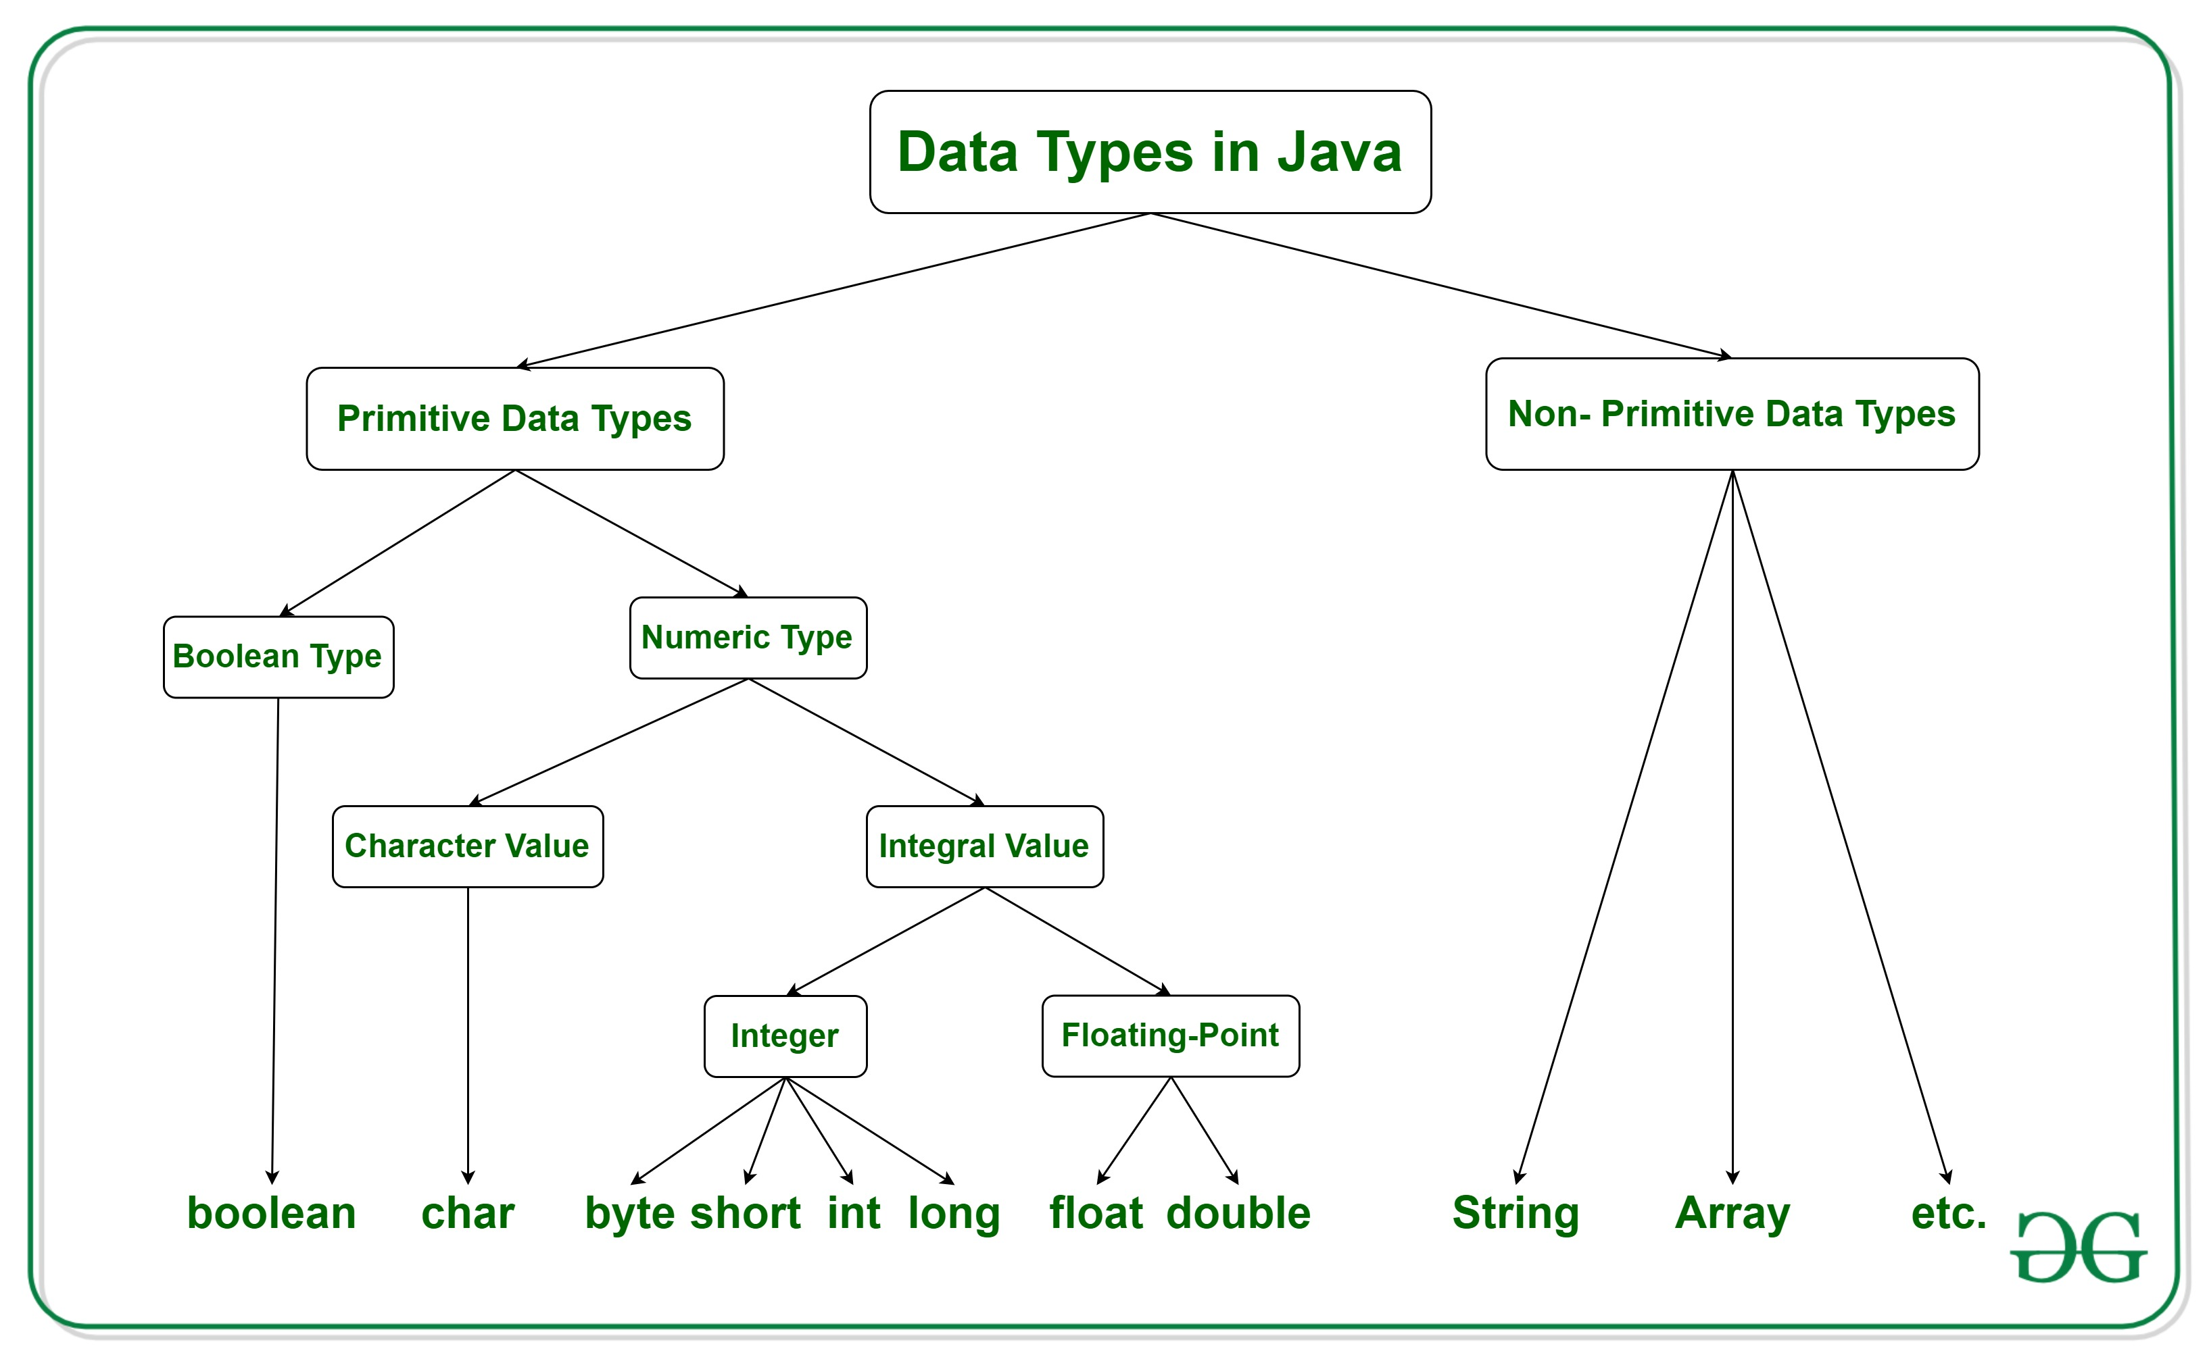
Data Types in Java

Slide 13
Numeric Operators

Slide 14
Integer Division
+, -, *, /, and %
5 / 2 yields an integer 2.
5.0 / 2 yields a double value 2.5
5 % 2 yields 1 (the remainder of the division)

Slide 15
double vs. float
The double type values are more accurate than the float type values. For example,
System.out.println("1.0 / 3.0 is " + 1.0 / 3.0);
System.out.println("1.0F / 3.0F is " + 1.0F / 3.0F);

Slide 16
Example of Arithmetic Expressions in Java
is translated to
(3+4*x)/5 – 10*(y-5)*(a+b+c)/x + 9*(4/x + (9+x)/y)

Slide 17
Order of evaluating expression
Though Java has its own way to evaluate an expression behind the scene, the result of a Java expression and its corresponding arithmetic expression are the same. Therefore, you can safely apply the arithmetic rule for evaluating a Java expression.

Slide 18
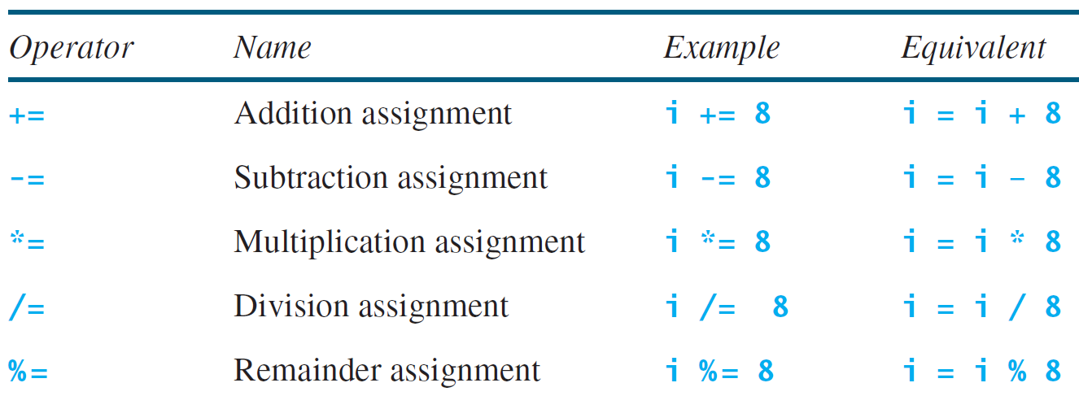
Augmented Assignment Operators

Slide 19
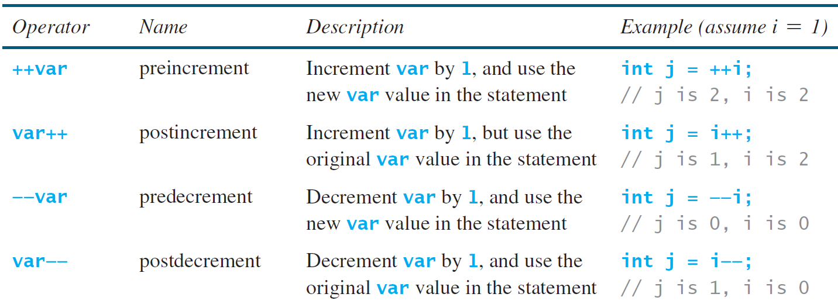
Increment and Decrement Operators

Slide 20
Increment and Decrement Operators, cont.

Slide 21
How to covert different value of a different type?*
Implicit casting
double d = 3; (type widening)
Explicit casting
int i = (int)3.0; (type narrowing)
int i = (int)3.9; (Fraction part is truncated)
What is wrong? int x = 5 / 2.0;

Slide 22
So what can you do with Java so far?
See examples in Textbook:
- 2.1 ComputeArea
- 2.2 ComputeAreaWithConsoleInput
- 2.3 ComputeAverage
- 2.4 ComputeAreaWithConstant
- 2.5 DisplayTime
- 2.6 FahrenheitToCelsius

Slide 23
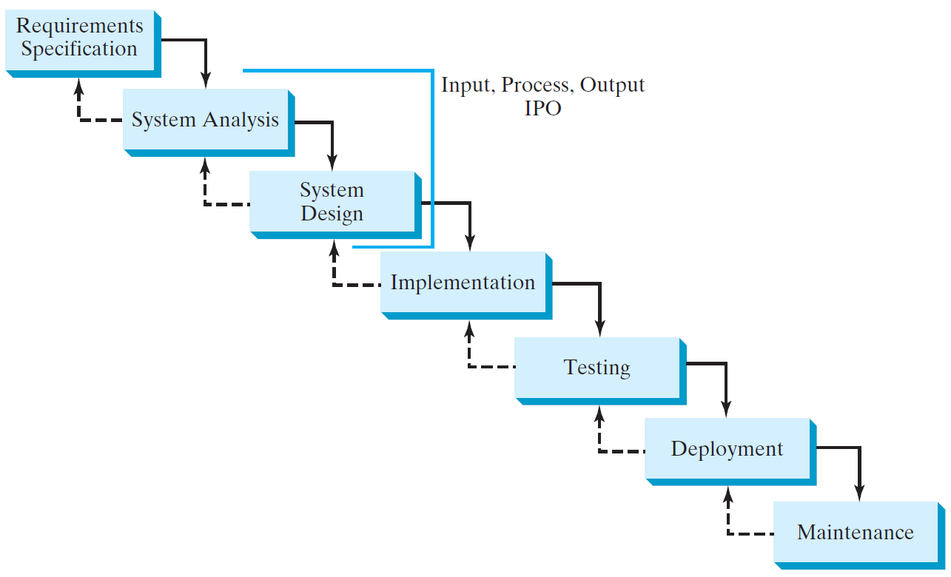
Software Development Process (SDLC)
What is SDLC?
Why should I care?

Slide 24
Exercises
See examples in Textbook (page 91-94):
- 2.1 Convert mile to kilometer
- 2.2 Convert the volume of a triangle
- 2.7 Find the numbers of years
- 2.14 Health application: computing BMI

